Slide 1
Effects of Benzodiazepines on the HPA Axis
Alex Wang
Daniel Ogunkunle
Krupa Patel

Slide 2
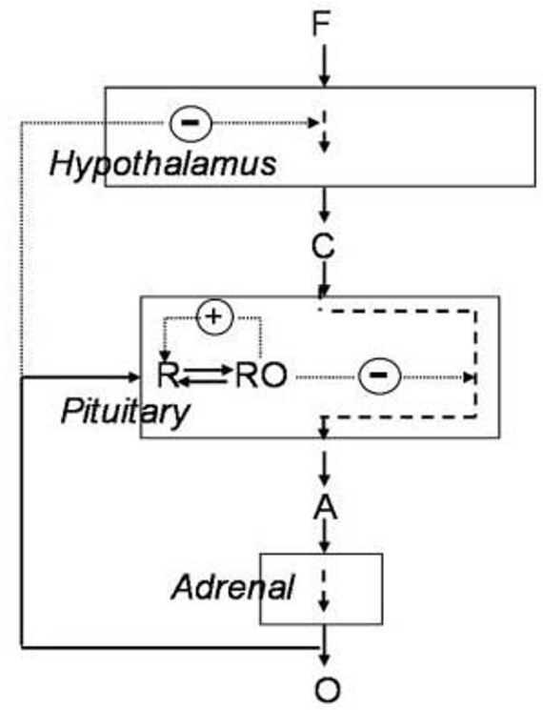
Introduction - HPA axis
F = Stress
Paraventricular Nucleus (PVN) in the hypothalamus secretes cortical releasing hormone (CRH)
CRH binds to receptors on the anterior pituitary gland and releases adrenocorticotropic hormone (ACTH)
ACTH binds to receptors on the adrenal gland and releases cortisol (O)
Negative feedback:
O negatively regulates CRH
O binds to glucocorticoid receptors on the pituitary forming a homodimer.
The homodimer negatively regulates ACTH
(Gupta, 2007)
KP

Slide 3
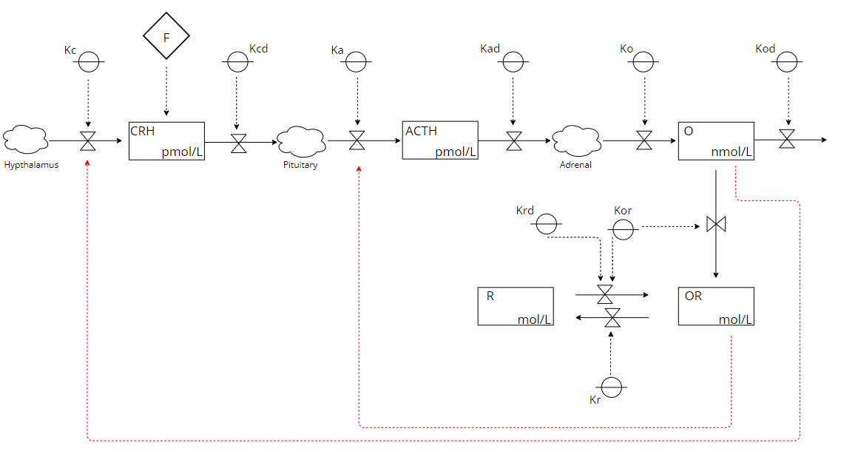
State Variables:
CRH (C)
ACTH (A)
Cortisol (O)
Glucocorticoid receptor (R)
Red arrows =
negative feedback
Forrester Diagram of the HPA axis
KP

Slide 4
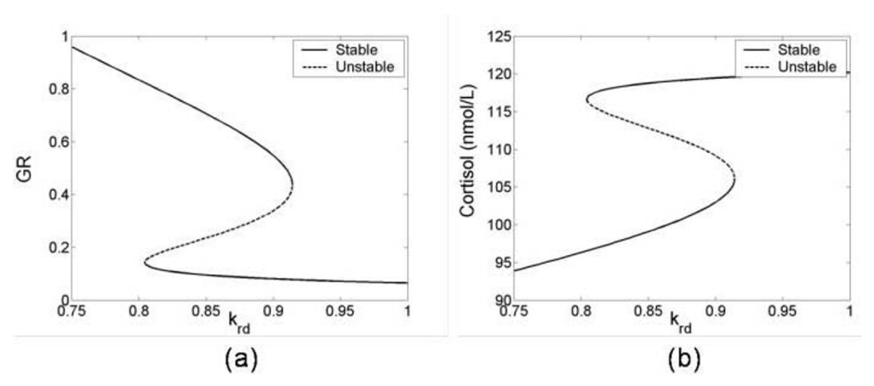
Introduction - Bistability
Inverse relationship due to negative feedback
The region where GR and Cortisol are multivalued, the patient can be pushed from one value of steady state to another.
(Gupta, 2007)

Slide 5
Introduction - Benzodiazepines
Anxiety:
Causes increase in cortisol levels
Treatment for Anxiety:
Benzodiazepines called Alprazolam (Xanax)
Exerts inhibitory effects on the HPA access by binding to GABAergic receptors on the hypothalamus causing hyperpolarization
Decreases production of CRH
KP

Slide 6
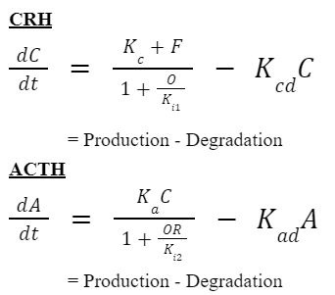
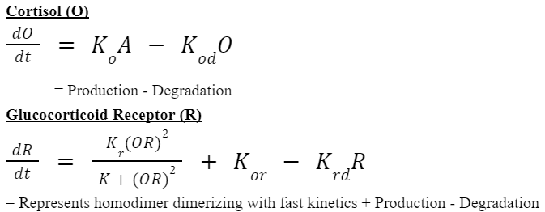
Mathematical Equations
AW

Slide 7
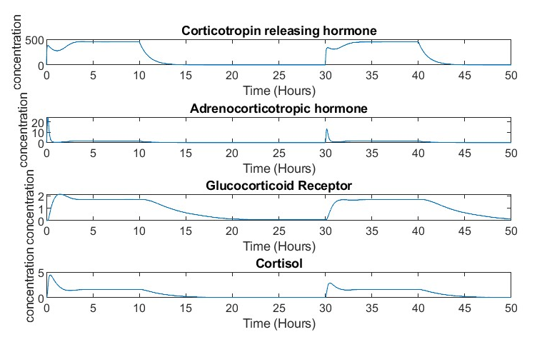
Simulation Results
Testing the simulation by introducing a chronic stress for 10 hours.
CRH levels quickly decreased due to its degradation
Glucocorticoid receptors increased when cortisol and ACTH decrease
With stress and Krd being constants, we see a stabilization after an hour
Altogether, we’ve demonstrated negative feedback
Transient responses of HPA axis to recursive stress
AW

Slide 8
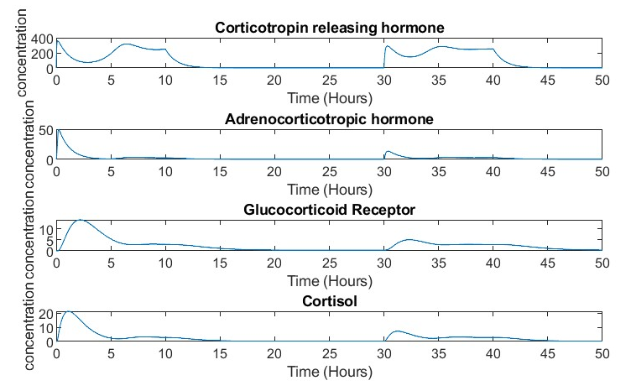
Simulation Results
Apply Benzodiazepines
The HPA axis under the influence of would decrease the parameters (C, A, R, O)
Alprazolam decreases the parameters by 70%
Results in a smaller amplitude compared to the normal state due to the drug's inhibitory effects. (Arvat, 1999)
Let’s examine in Matlab!
Transient responses of HPA axis under the influence of benzodiazepines to recursive stress
AW

Slide 9
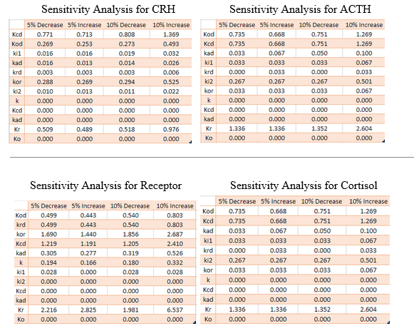
Sensitivity Analysis
DO

Slide 10
Conclusion
Krd:
When Krd is high, GR concentration is at a low steady state
When Krd is low, GR concentration is at a high steady state
Depending on Krd, extreme stress can push subjects into different steady states
DO

Slide 11

Conclusion
HPA axis has a central role in regulating homeostatic systems in the body…
Metabolic
Cardiovascular
Immune
Reproductive
CNS
Generalized anxiety disorder = Hypercortisolism
PTSD = hypersecretion of CRH with consequent down-regulation
Alprazolam inhibits the HPA axis, causing downstream effect to downregulate cortisol
Focus for future studies?
Novelty?
DO

